Slide 1
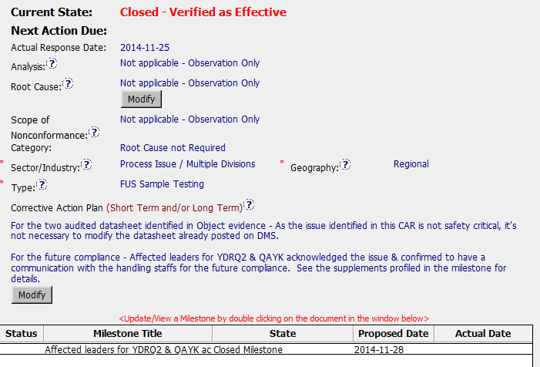
CAR 143914149
It does not fix the problem identified in the “Objective Evidence”.
Not necessary to go beyond addressing the objective evidence.
No milestone included to fix the problem.

Slide 2
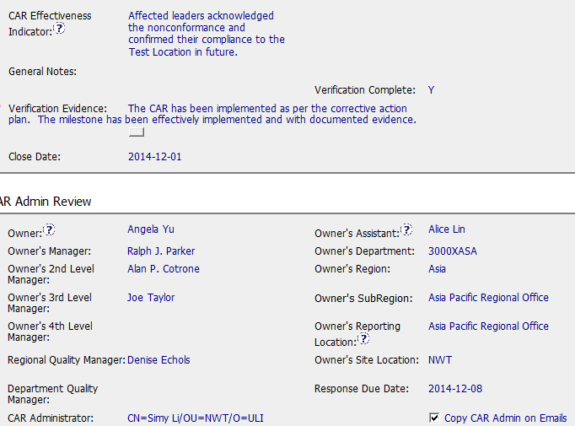
CAR 143914149
Following the criteria of corrective action plan.
Closed the same day the milestone was approved

Slide 3
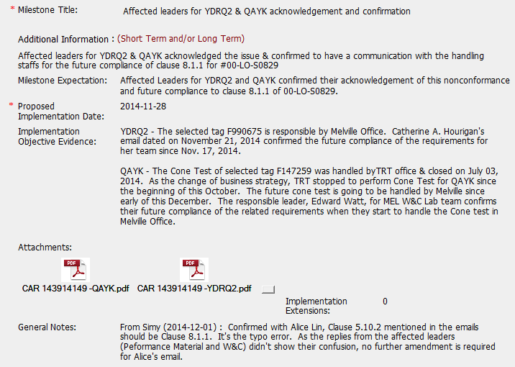
CAR 143914149
Milestone expectation correct
Evidence attached is in compliance with milestone expectation.

Slide 4



CAR 143914149
INTEGRITY
Initiative & Decision Making Analyzing & Problem Solving | Facilitates progression of the CAR through closure: extensions, escalations, reassignments, etc. Accurately completes the administrative fields within the CAR such as root cause category, process impacted, geography, etc. Acts on CARs within the required timeframe Facilitates the handling of disputed CARs (C) Extensions are within requirement (<30 days, 3 or less) (T) Most appropriate ‘category’, ‘type’, ‘geography’ are selected (P) Facilitates the handling of disputed CARs (T) Acts on CARs within required timeframe
COMPETITIVENESS
Customer Focus Achieve Business Results Flexibility | Assists customers as they address all aspects of the CAR – analysis, root cause statement, milestone, containment, verification, etc. Verifies CARs timely (C) Analysis shows clear path to root cause and scope; stakeholders identified (C) Root cause statement is succinct, reasonable, complete (Shows ‘N/A’ for observations) (C) Corrective actions fix the objective evidence and other problems found; address entire root cause and scope. For observations, they do not go beyond fixing the objective evidence (C) Milestones address containment & owner’s verification; completed per milestone expectations (P) Verification per requirements
COLLABORATION
Leading & Engaging Teamwork Communication | Provides pertinent feedback at appropriate times; shares information and keeps others informed Supports other CAR Champions by serving as their backup when they are absent Works as a team player with other CAR Champions (L) Referenced communications are attached as needed (C L) Evidence of communication for overdue/escalated CARs and other pertinent concerns (P) Trains other CAR Champions
CL

